Slide 1



2025
Graduation Project
Welcome to
UniSearch
Presented by
Abdurashidov Azizbek - 220095
Olimov Kamronbek - 220080
Supervisor
Faculty
Estabilishment
Danesh Shehzad
School of Computing
New Uzbekistan University
Page
01

Slide 2
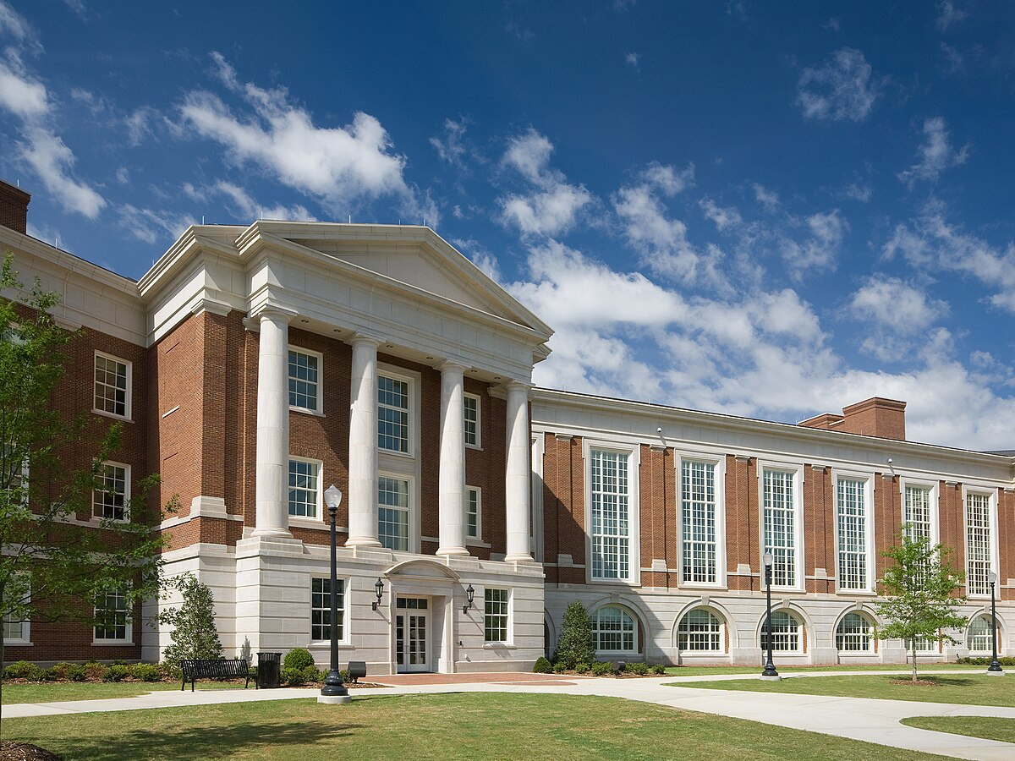
Introduction & Motivation
Student Challenges
Scattered university information across multiple websites
Missing application deadlines due to lack of centralized tracking
Difficulty comparing tuition fees and scholarship options
Complex English language requirements and testing information
Regional Focus
Particularly challenging for students from Central Asia
Limited access to educational guidance and consulting
Page
02
Page
02

Slide 3

Aims & Objectives
Key features
Easy-to-Use Platform
Structured Database
Country & Budget Filters
Develop an intuitive web platform for searching universities with comprehensive filters and smart
recommendations
Build a comprehensive database of universities with accurate information on programs, costs, and requirements
Scholarship Availability
Program Details
IELTS score flitering
AI Recommendations
Accessible Information
Application deadlines
Implement a lightweight AI module to classify universities as Safe, Match, or Ambitious based on student profiles
Provide detailed university pages with programs, costs, requirements, and deploy publicly for student access
Mobile Responsive
www.reallygreatsite.com
Page
04
Page
03

Slide 4
Literature Review
University Search
Platforms
StudyPortals
Global program search but lacks deadline tracking and scholarship information
ApplyBoard
Consultant-based platform with limited self-service and no personalized recommendations
CollegeBoard BigFuture
Useful for U.S. universities only, not international students
Web Scraping
Technologies
Anti-Bot Protection
Modern websites implement CAPTCHA, IP rotation detection, and behavioral analysis
Rotation Techniques
Successful scraping requires
rotating proxies, user agent spoofing, and CAPTCHA solving
Legal Considerations
Ethical scraping requires respecting robots.txt and implementing rate limiting
Recommendation Systems
Multi-Factor Analysis
Modern systems consider
academic performance, financial constraints, and career goals
Explainable AI
Educational contexts require
transparent recommendations
that users can understand
Hybrid Approaches
Combining collaborative filtering with content-based methods addresses cold start problems
Page
04

Slide 5
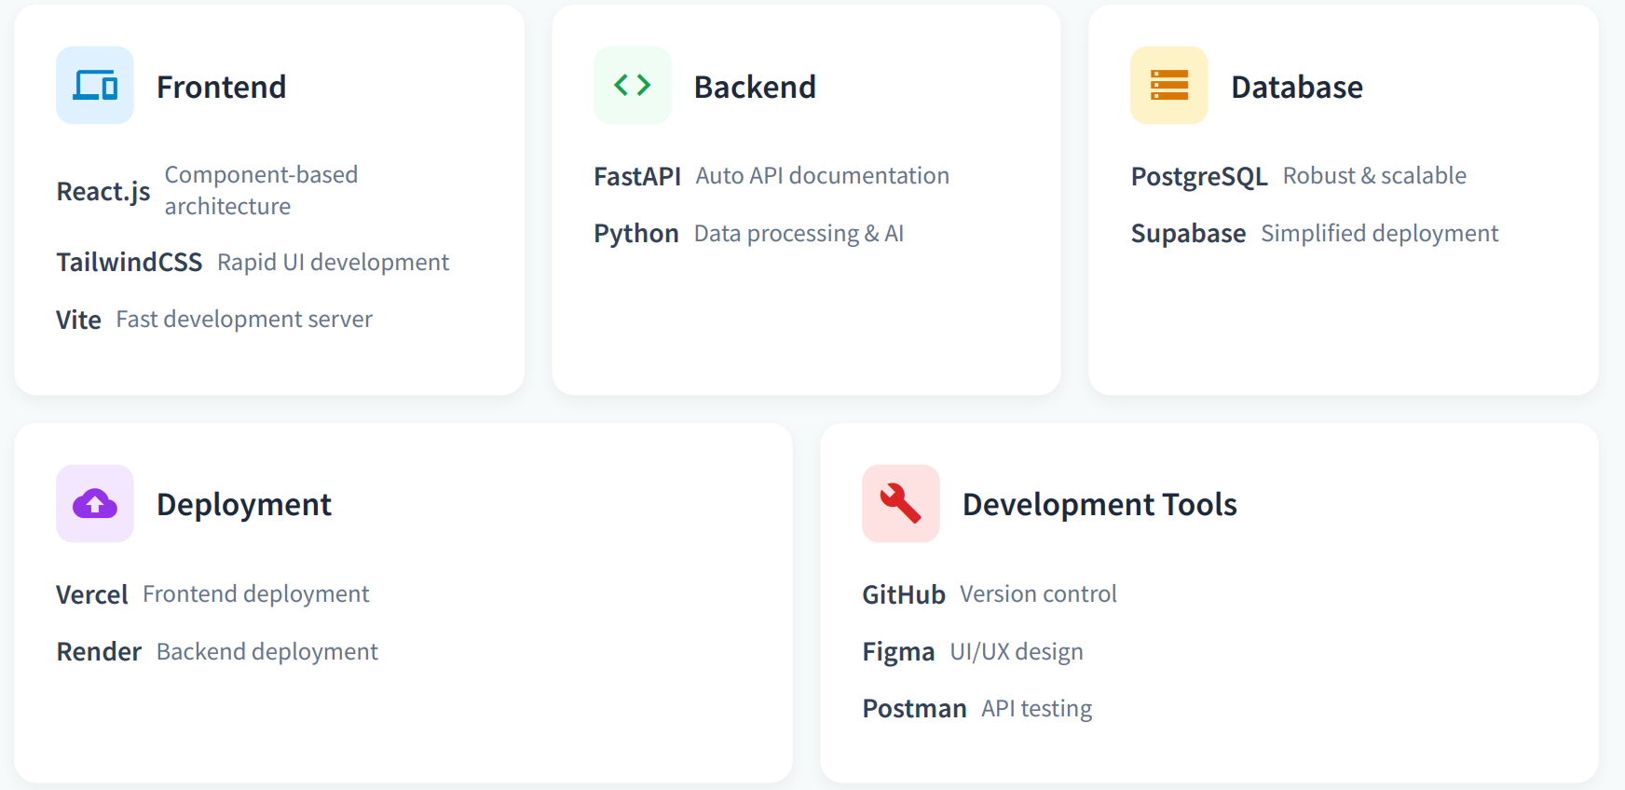
Technology Stack
Page
07
Page
05

Slide 6







Methodology
Development approach
Planning
Development
Testing
Deployment
Data collection strategy
Web scrapping
Manual collection
Partnerships
Python scripts with
Selenium and Beautiful Soup
For critical data
points (deadlines, fees)
Educational consulting
agencies for verified data
Page
06

Slide 7

Project timeline
Data collection
Web scrapping
Sample data prep
Backend development
API integration
WEEK 1-2
WEEK 3-5
WEEK 4-6
WEEK 6-8
SEMESTER 2
Requirement analysis
System design
UI/UX Planning
Frontend development
Static data integration
UI implementation
Recommendation Engine
Testing & Deployment
www.reallygreatsite.com
Page
08
Page
07

Slide 8

Current Status
Completed Tasks
Project proposal and requirements analysis
Technology stack selection
Initial web scraping experiments
Sample data preparation for development
Basic system architecture design
Frontend implementation with static data
In Progress
Database schema design
UI/UX mockups
API endpoint planning
Challenges Encountered
Web scraping limitations due to CAPTCHA and dynamic content
Project scope adjustment following supervisor change
Timeline constraints due to delayed project finalization
Current progress: 60% complete
Page
08

Slide 9
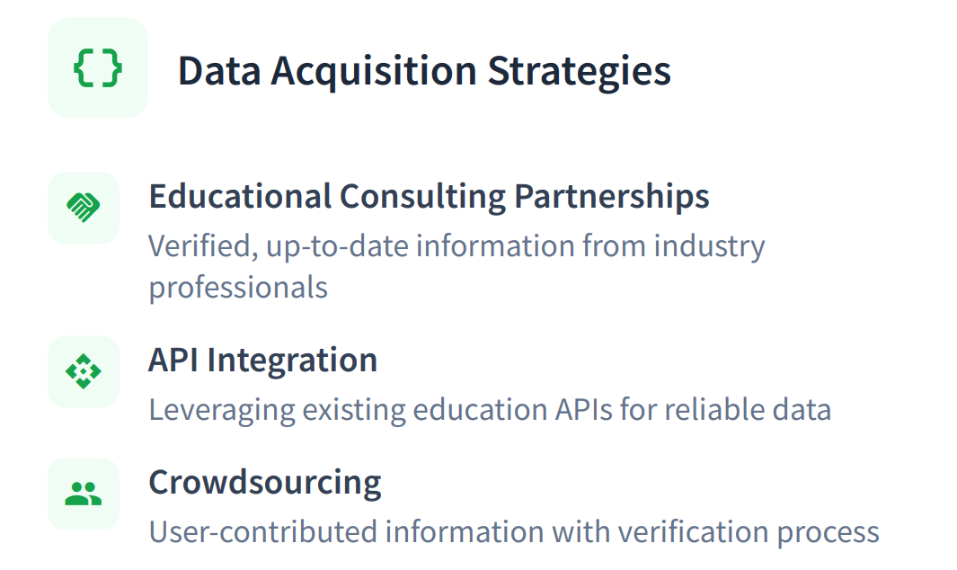
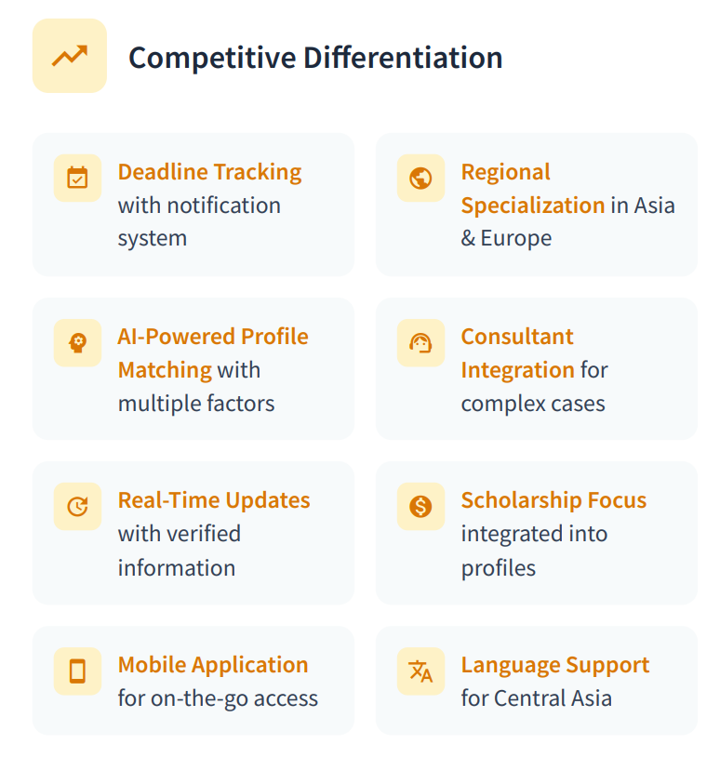
Future Work & Competitive Analysis
Page
09

Slide 10
Conclusion
Key Insight
UniSearch bridges the critical gap in university information access, particularly for students from Central Asia,
providing centralized, accurate, and timely data with AI-powered recommendations and comprehensive
deadline tracking.
Progress summary
Frontend completed with responsive design
Sample dataset of 50 Asian universities prepared
Technology stack finalized and system architecture designed
Key Insights
Web scraping limitations require hybrid data strategy
Educational consulting partnerships are critical for data quality
Clear differentiation opportunities exist in deadline tracking and regional focus
Next Steps
Complete backend API development and database design
Implement recommendation engine with profile matching
Establish educational consulting partnerships for data acquisition
Page
10

